Slide 1
Machine Learning Final Project
-Jiacheng Shen(js12556)

Slide 2
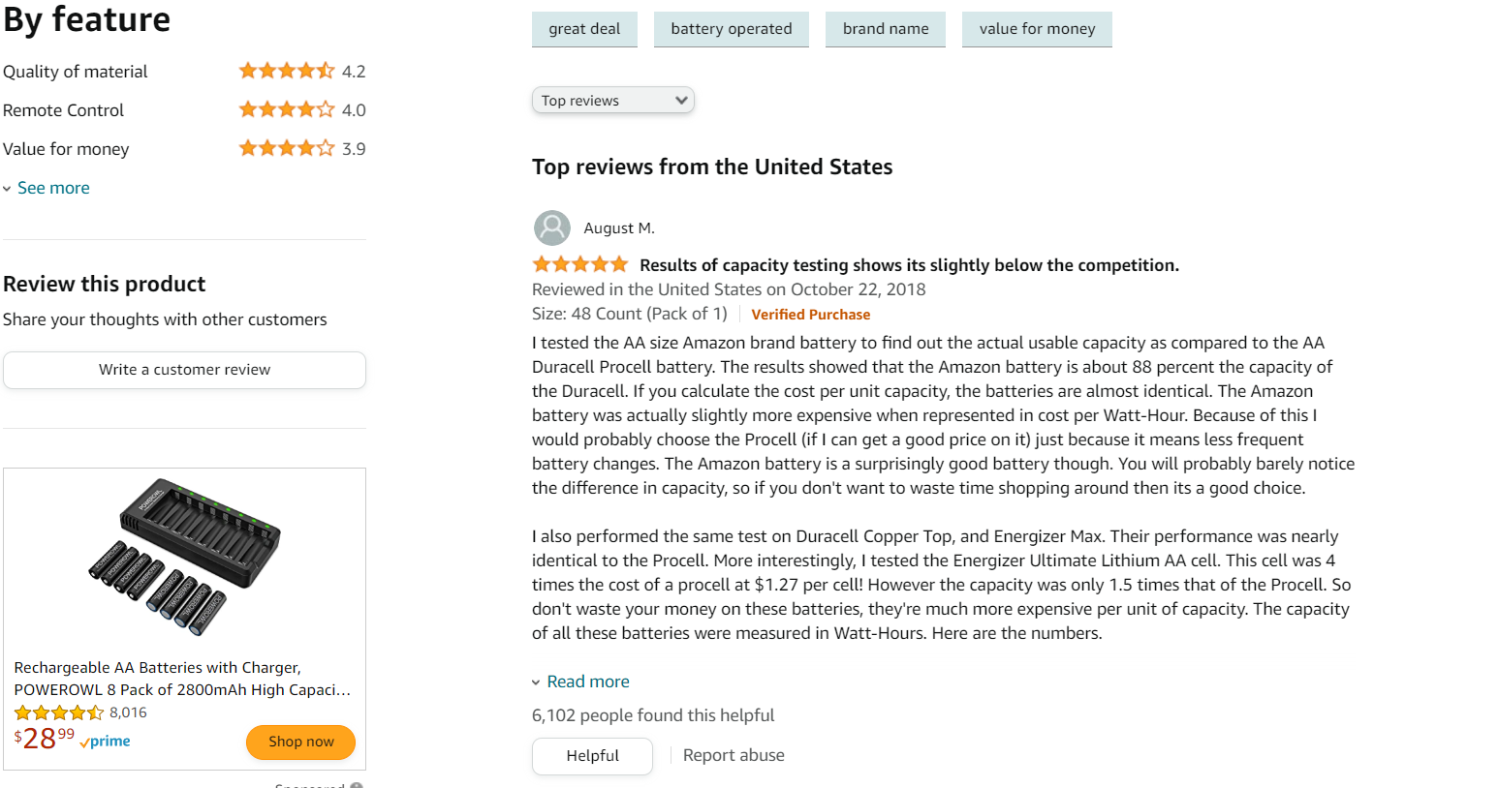
Problem formulation
Text classification of Amazon review.

Slide 3
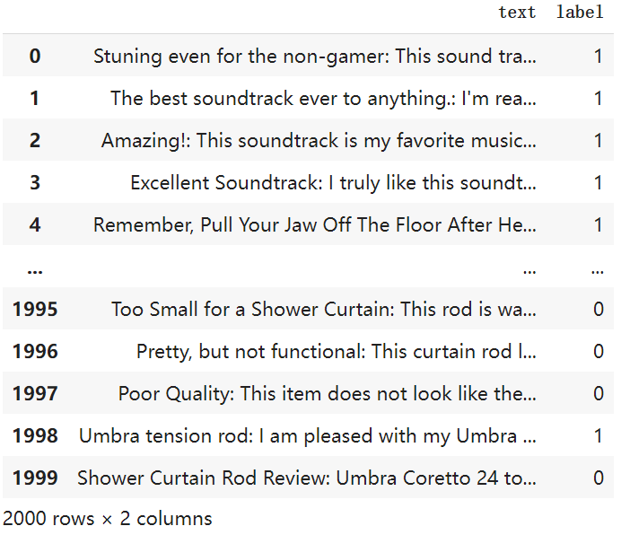
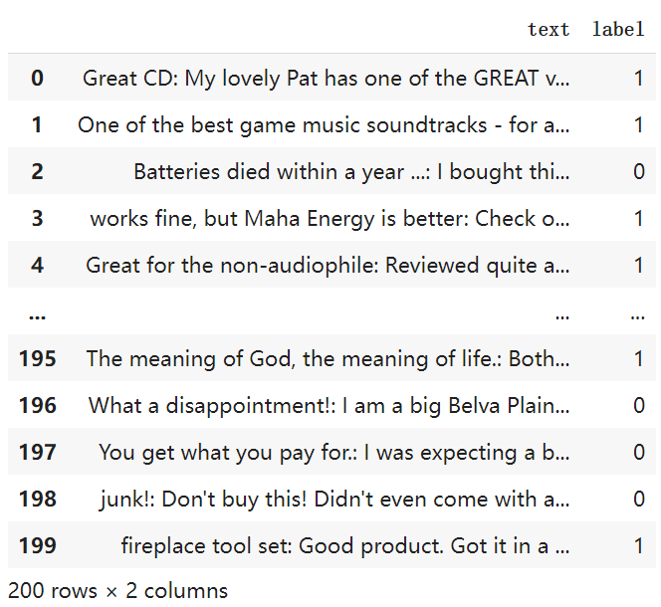
Data pre-processing

Slide 4
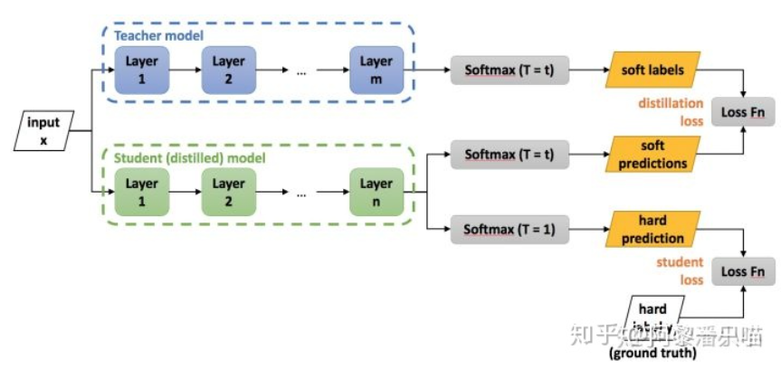
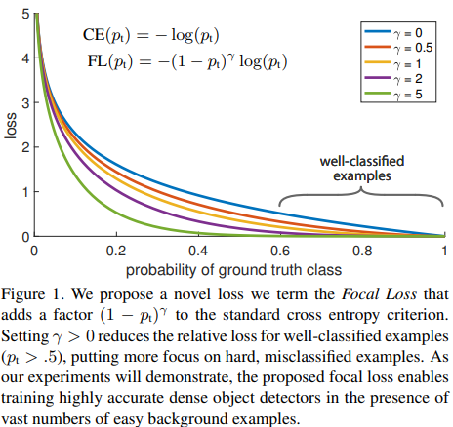
Background Knowledge
Knowledge distillation
Focal loss

Slide 5
Training Algorithm
Encoding with tokenizer
Use Adam, cross-entropy or focal loss, and gradient clipping to perform training step.
Evaluate performance on validation set and test set
Repeat step 1-3 repeatedly for every Bert Family model
Compare models based on evaluation of same test set.

Slide 6
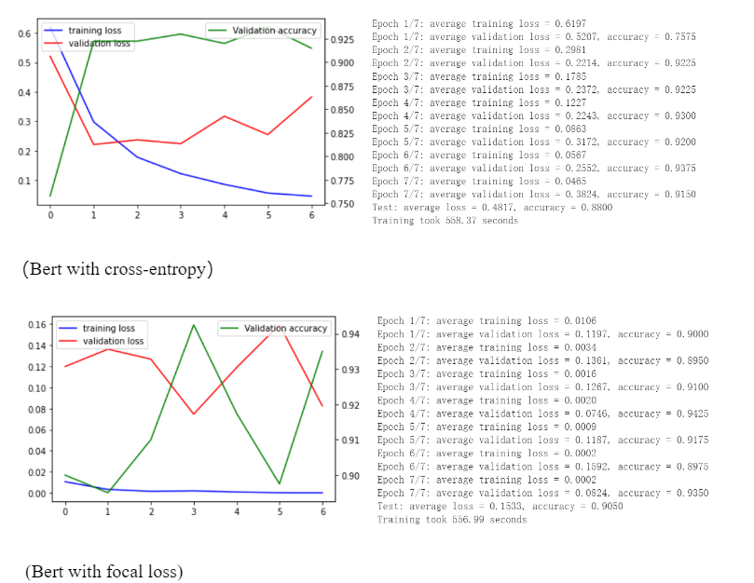
Focal loss and cross-entropy

Slide 7
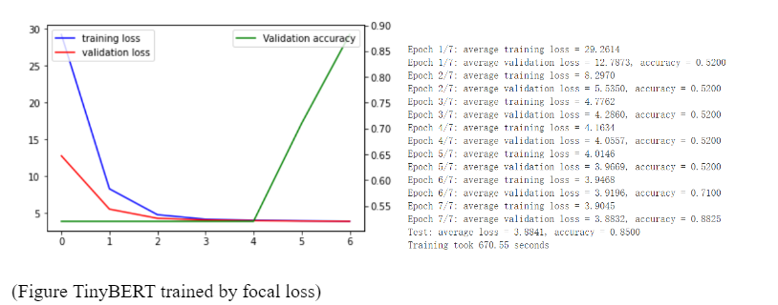
TinyBERT

Slide 8
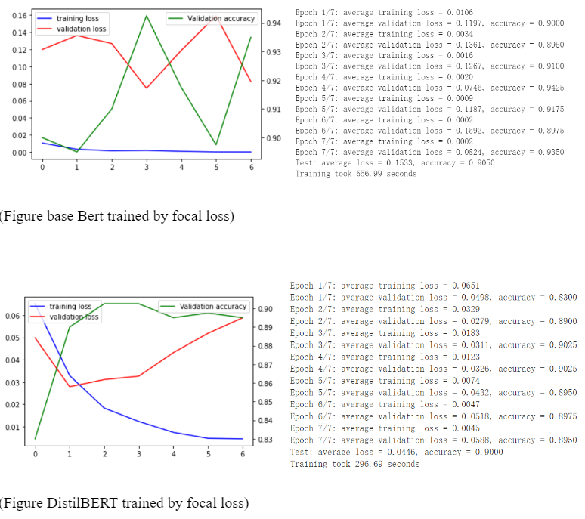
DistilBERT and base Bert

Slide 9
Conclusion
Longer time
Stronger GPU
Multi-classification

